Slide 1
Section 5.3 Scaled Factors for Lengths, Areas, and Volumes
“Scale Factors”

Slide 2
Scale Factors and Similar Objects
Suppose you take a triangle and increase all the sides by a factor of 3, then each side will be 3 times longer than it used to be:
If you increase all the sides by the same scale factor, then the object will be “similar”, meaning all the sides will be in ratio and corresponding angles are equal
Two objects are similar if all the sides are in “ratio” and corresponding angles are equal
Similar Triangles
NOT Similar

Slide 3
Ex: Indicate if the following statements are TRUE or FALSE
a) Two objects are similar if they look exactly alike but one objects is bigger than the other
b) Two different squares are always going to be similar to each other
c) Two different rectangles are always going to be similar to each other
d) If two triangles have all corresponding angles equal (AAA) then they must be similar

Slide 4
I) SCALING AN OBJECT (SCALE FACTORS)
Scaling means making something bigger/smaller.
A “scale factor” is used when you want to increase something by a constant number
Scale Factor
Of “3”
When a “scale factor” is used, the Width and Length will increase by the same constant.
The object will increase proportionally and all sides will be in “ratio” (Look the same, except bigger)

Slide 5
How do Scale Factors affect length, Area and Volume?
The notation for the scale factor is “k”
Scale factors tell us how many times an object is “scaled” to make it bigger or smaller
A “scaled factor” of 10 means that an object is made 10 times bigger [all lengths are 10 times longer]
A “scaled factor” of 0.5 means that an object is made half as big [all the lengths are half as long ]
The Area of a scaled object will increase or decrease by a factor of “k to the power of 2” or [k²]
For instance, if a triangle is increased by a scaled factor of k=2, then the area of the triangle will increase by k² = 4
Ie: if a triangle is increased by a scaled factor of k=3, then the area of the triangle will increase by k² = 9
The Volume of a scaled object will increase or decrease by a factor of “k to the power of 3” or [k³]

Slide 6
Ex: If the lengths of all the sides in ΔDEF is 3 times longer than the sides in ΔABC, how many times greater is the area is ΔDEF ?
Let the base of the little triangle be ‘x”
The area of the bigger triangle will be 9 times bigger
Then the base of the big triangle be ‘3x”
Let the height of the little triangle be ‘h”
Then the height of the big triangle be ‘3h”

Slide 7
EX: A BOX IS INCREASED BY A SCALE FACTOR OF 4. HOW MANY TIMES BIGGER IS THE VOLUME OF THE NEW BOX?
The Larger Box will have a volume that is 64 times bigger!

Slide 8
PRACTICE: THE FOLLOWING CYLINDER IS INCREASED BY A SCALE FACTOR OF 3. HOW MANY TIMES LARGER IS THE SURFACE AREA?
The Larger Cylinder will have a Surface Area that is 9 times bigger!

Slide 9
III) How many Times Larger With a Scale Factors “k”:
When using “scale factors” to scale an object
The Length or Width will be “k” times longer
If “k=5” , the Length or Width will be “5” times longer
The Surface Area will be “k²” times larger
If “k=5” , the Surface Area will be “25” times larger
If “k=5” , the Volume will be “125” times larger
The Volume will be “k³” times larger

Slide 10
Suppose a regular hexagon has a side length of 1 and another regular hexagon with a side length of 3, then which of the following statement(s) are true?
A) Bigger hexagon has a perimeter 3 times larger than perimeter of smaller hexagon
B) Bigger hexagon has a perimeter 9 times larger than perimeter of smaller hexagon
C) Bigger hexagon has an area 3 times larger than area of smaller hexagon
D) Bigger hexagon has an area 9 times larger than area of smaller hexagon
E) You can not determine the area or their ratio without having an image of the hexagon

Slide 11
Ex: A MODEL JET IS BUILT TO A SCALE OF 1:150. IF THE MODEL JET HAS A SURFACE AREA OF 350CM², WHAT IS THE S.A. OF THE REAL JET?
Ex: A JUICE BOX HAS A VOLUME OF 250ML. THE BOX WAS INCREASED BY A SCALE FACTOR “K” TO A LARGER VOLUME OF 1000ML. WHAT IS THE VALUE OF “K”
Ex: The area of a little square is 25% of a larger square. If the side length of the bigger square is “k”, then what is the side length of the smaller square?

Slide 12
Ex: A MODEL JET IS BUILT TO A SCALE OF 1:150. IF THE MODEL JET HAS A SURFACE AREA OF 350CM², WHAT IS THE S.A. OF THE REAL JET?
Find the Scale Factor:
Scale:
The length of the actual jet will be 150 times longer than the model.
Therefore, the scale factor will be:
The Surface Area will be “k²” times larger

Slide 13

Ex: A JUICE BOX HAS A VOLUME OF 250ML. THE BOX WAS INCREASED BY A SCALE FACTOR “K” TO A LARGER VOLUME OF 1000ML. WHAT IS THE VALUE OF “K”
The scale factor is 1.59

Slide 14
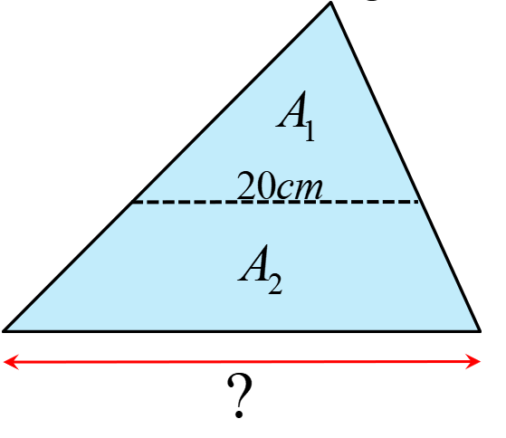
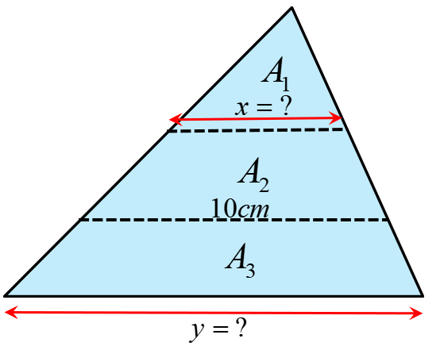
Q: The area of a little square is 25% of a larger square. If the side length of the bigger square is “X”, then what is the side length of the smaller square?
Q2: The following triangle is cut into two pieces of equal areas: A1 and A2. If the length of the dotted line is 20cm, then what is the length of the base?
Q3: Two horizontal lines cut the following triangle into 3 equal areas. If the length of one of the lines is 10cm, then what is the length of “x” and “y”?

Slide 15
Q: The area of a little square is 25% of a larger square. If the side length of the bigger square is “X”, then what is the side length of the smaller square?

Slide 16
Q2: The following triangle is cut into two pieces of equal areas: A1 and A2. If the length of the dotted line is 20cm, then what is the length of the base?

Slide 17
Q3: Two horizontal lines cut the following triangle into 3 equal areas. If the length of one of the lines is 10cm, then what is the length of “x” and “y”?

Slide 18
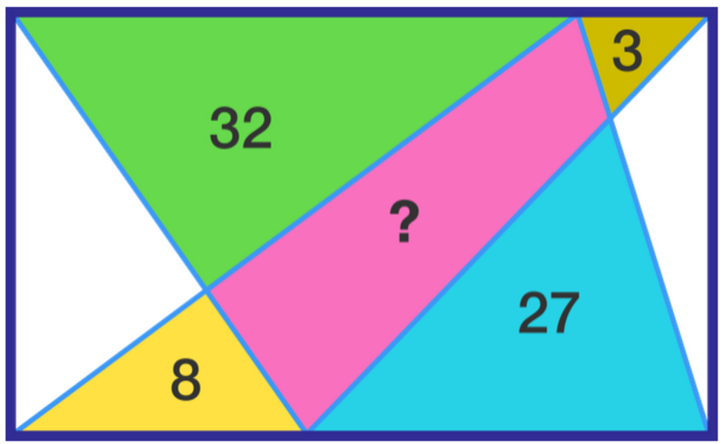
Challenge: Given the area of the following triangles, find the area of the pink quadrilateral

